Slide 1

Statistical Presentation

Slide 2
Introduction

Slide 3
Total sample | ??
% of people drink alcohol | ??
% of women in the sample | ??
Highest educational level- | ??
Divorced | ??
Separated | ??
How many people are included in the sample?
b. What is the percentage of people who drink alcohol?
c. What is the percentage of women in the sample?
d. What is the highest educational level?
e. What is percentage of divorced and separated people?
** Below the table, interpret the data

Slide 4
Descriptive Statistics
a. How many people are included in the sample? | Total Sample | 10617
b. What is the percentage of people who drink alcohol? | % of people drink alcohol | 63.2%
c. What is the percentage of women in the sample? | % of women in the sample | 54.3%
d. What is the highest educational level? | Highest educational level- | NVQ4/NVQ5/Degree
e. What is percentage of divorced and separated people? | Divorced Separated | 5.6% 2%

Slide 5
Find the mean, median, mode, minimum, maximum, range and standard deviation of household size, BMI and age at last birthday
 | Household size | BMI | Age at last birthday
Mean | 2.9 | 25 | 41.6
Median | 3 | 25.6 | 42
Mode | 3 | 21 | 3
Minimum | 1 | 8.3 | 0
Maximum | 10 | 65.3 | 100
Range | 9 | 56.9 | 100
Standard deviation | 1.4 | 6.1 | 23.8

Slide 6
Inferential Statistics
a. Run a significance test to find out which gender drinks more alcohol
The null hypothesis (H0) is that there is no difference in alcohol consumption between genders
The Alternative hypothesis (HA) is that there is difference in consumption between genders

Slide 7
Inferential Statistics cont.
 | Drinking Status |  | Value of the test and p value
Gender | Yes N (%) | No N (%) | Chi-square = 114.15 P-value = 2.2e-16
Male | 3172 (37.16%) | 605 (7.1%)
Female | 3540(41.48%) | 1217 (14.26%)
Based on the chi-square p-value (2.2e-16) which is less than 0.05, we reject the null hypothesis and conclude that there is a statistically significant difference in alcohol consumption between genders.

Slide 8
Inferential Statistics
b. Run a significance test to find out which region drinks the most alcohol
The null hypothesis (H0) is that there is no difference in alcohol consumption among regions
The Alternative hypothesis (HA) is that there is difference in consumption among regions

Slide 9
 | Drinking Status |  | Value of the test and p value
Region | Yes | No | Chi-square = 979.74 P-value = 0.0004998
White - English/Welsh/Scottish/Northern Irish/British | 5925 (69.5%) | 1219 (14.3%)
White - Irish | 62 (0.72%) | 15 (0.17%)
White - Gypsy or Irish Traveler | 2 (0.02%) | 1 (0.01%)
Any other white background | 326 (3.82%) | 88 (1%)
White and Black Caribbean | 23 (0.26%) | 3 (0.03%)
White and Black African | 8 (0.09%) | 2 (0.02%)
White and Asian | 17 (0.2%) | 13 (0.15%)
Any other mixed/multiple ethnic background | 18 (0.2%) | 13 (0.15%)
Indian | 100 (1.17%) | 105 (1.23%)
Pakistani | 6 (0.1%) | 134 (1.6%)
Bangladeshi | 5 (0.06%) | 41 (0.48%
Chinese | 26 (0.3%) | 8 (0.1%)
Any other Asian background | 52 (0.6%) | 45 (0.5%)
African | 46 (0.5%) | 72 (0.8%)
Caribbean | 53 (0.6%) | 25 (0.3%)
Any other Black/African/Caribbean background | 18 (0.2%) | 4 (0.05%)
Arab | 4 (0.05%) | 17 (0.2%)
Any other ethnic group (please describe) | 11 (0.12%) | 15 (0.17%)
Based on the chi-square p-value (0.0004998) which is less than 0.05, we reject the null hypothesis and conclude that there is a statistically significant difference in alcohol consumption among regions.

Slide 10
Investigate whether there is a statistical difference between men and women on the following variables: i. Valid height
Null Hypothesis (H0): There is no difference in height between men and women.
Alternative Hypothesis (H1): There is a difference in height between men and women.

Slide 11
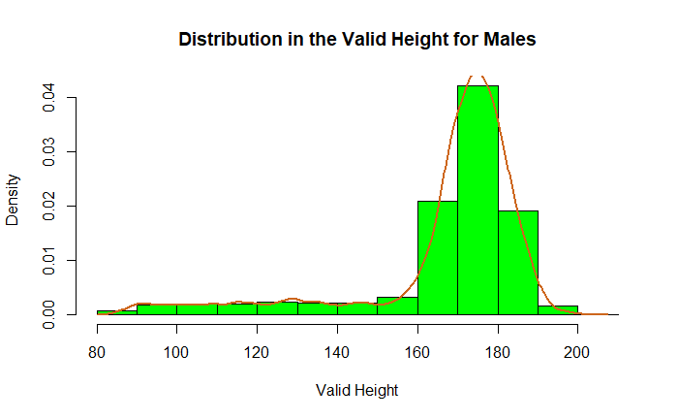
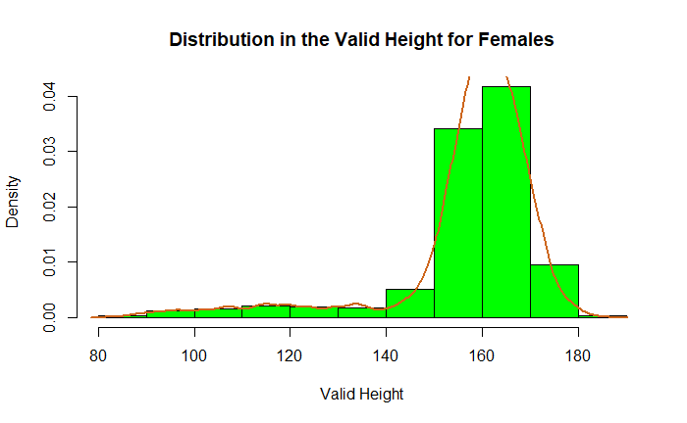
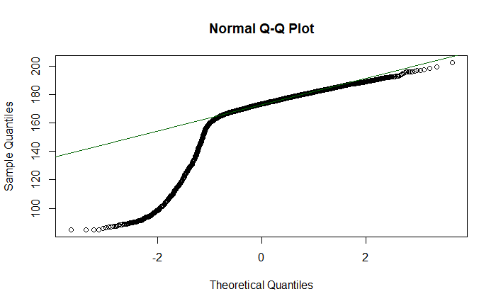
check for normal distribution in the height data
Shapiro-Wilk normality test
data: males_data$htval
W = 0.73755, p-value < 2.2e-16
the Shapiro-Wilk normality test p-value for height is 2.2e-16, which is less than 0.05 , this means that the data does not follow a normal distribution therefore we shall use man whitney u test

Slide 12
Since height is non parametric we are using the Man-whitney U test to check whether there is a statistical difference between men and women in height.
wilcox.test(htval ~ Sex, data = height_weight)
Wilcoxon rank sum test with continuity correction
data: htval by Sex W = 14713021, p-value < 2.2e-16 alternative hypothesis: true location shift is not equal to 0
The p-value is 2.2e-16 which is less than 0.05, we reject the null hypothesis and say that the difference in height is statistically significant between males and females

Slide 13
Investigate whether there is a statistical difference between men and women on the following variables: i. Valid weight
Null Hypothesis (H0): There is no difference in weight between men and women.
Alternative Hypothesis (H1): There is a difference in weight between men and women.

Slide 14
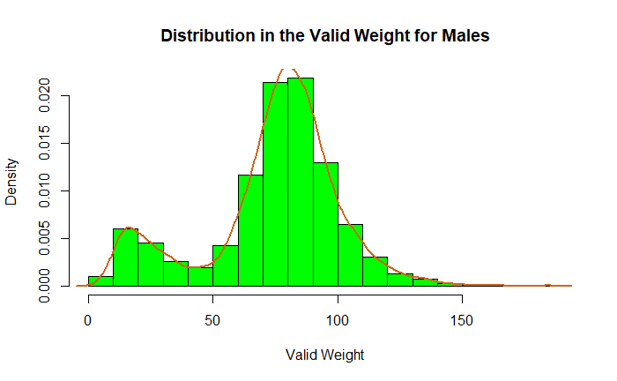
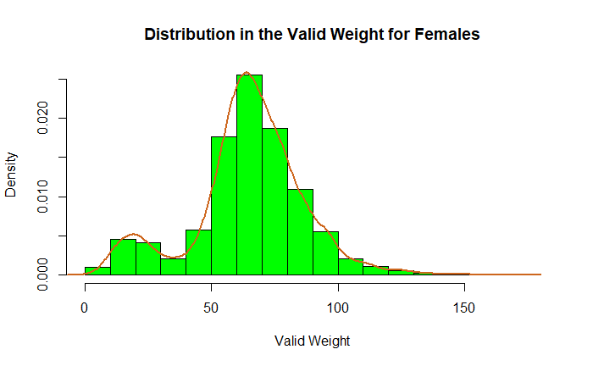
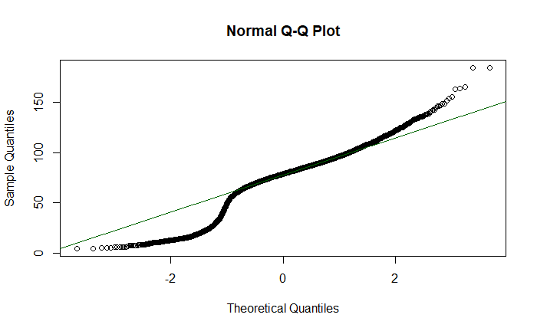
check for normal distribution in the weight data
Shapiro-Wilk normality test
data: males_data$wtval
W = 0.93674, p-value < 2.2e-16
the Shapiro-Wilk normality test p-value for weight is 2.2e-16, which is less than 0.05 , this means that the data does not follow a normal distribution therefore we shall use man whitney u test

Slide 15
Wilcoxon rank sum test with continuity correction data: wtval by Sex W = 12449400, p-value < 2.2e-16 alternative hypothesis: true location shift is not equal to 0
Since height is non parametric we are using the Man-whitney U test to check whether there is a statistical difference between men and women in weight.
wilcox.test(wtval ~ Sex, data = height_weight)
Wilcoxon rank sum test with continuity correction
data: htval by Sex W = 14713021, p-value < 2.2e-16 alternative hypothesis: true location shift is not equal to 0
The p-value is 2.2e-16 which is less than 0.05, we reject the null hypothesis and say that the difference in weight is statistically significant between males and females

Slide 16
What is the correlation between whether a person drinks nowadays, total household income, age at last birthday and gender?
 | Drink now a days | Total household income | Age at last birthday | Gender
Drink now a days |  | r=-0.15 p-value <2.2e-16 | r=0.06 p-value = 1.871e-10 | r=0.11 p-value < 2.2e-16
Total household income | r=-0.15 p-value <2.2e-16 |  | r=-0.04 p-value = 1.125e-05 | r=-0.04 p-value = 2.172e-05
Age at last birthday | r=0.06 p-value = 1.871e-10 | r=-0.04 p-value = 1.125e-05 |  | r=0.032 p-value = 0.0007558
Gender | r=0.11 p-value < 2.2e-16 | r=-0.04 p-value = 2.172e-05 | r=0.032 p-value = 0.0007558

Slide 17
Correlation interpretation
• drinks now days and total household income
The sample estimate of the Spearman correlation coefficient is -0.15 indicating a is a weak negative association between the two variables.
• drinks now days and age at last birthday
The sample estimate of the Spearman correlation coefficient is 0.06 indicating a weak positive correlation between the two variables
• drinks now days and gender
The sample estimate of the Spearman correlation coefficient is -0.11 indicating a weak negative correlation between drinks now days and gender
• household income and age at last birthday
The sample estimate of the Spearman correlation coefficient is -0.04 indicating a weak negative correlation between total household income and age at last birthday
• total household income and gender
The sample estimate of the Spearman correlation coefficient is -0.04 indicating a weak negative correlation between total household income and gender
• age at last birthday and gender
The sample estimate of the Spearman correlation coefficient is 0.032 indicating a weak positive correlation between age at last birthday and gender
In summary, all the p-values are less than 0.05 so we reject the null hypothesis of no correlation between the variables.

Slide 18
A discussion of findings with reference to relevant literature on gender and alcohol in the UK
Arsalan et al. (2016) argue that there is a consistent rise in alcohol consumption among women, although males still exhibit higher overall consumption, the statistically significant but weak negative correlation between gender and alcohol consumption in the UK population, with a correlation coefficient of -0.11, suggests minor association
According to Davoren et al. (2016), there is notable narrowing of the gender gap in alcohol consumption among university students in Ireland and the United Kingdom from 2002 to 2014
There is larger reductions in alcohol consumption rates among men at a 5.3% rate (Meier et al.,2021).
References:
Moinuddin, A., Goel, A., Saini, S., Bajpai, A. and Misra, R., 2016. Alcohol consumption and gender: a critical review. J Psychol Psychother, 6(3), pp.1-4.
Davoren, M.P., Demant, J., Shiely, F. and Perry, I.J., 2016. Alcohol consumption among university students in Ireland and the United Kingdom from 2002 to 2014: a systematic review. BMC public health, 16(1), pp.1-13.
Meier, P.S., Holmes, J., Brennan, A. and Angus, C., 2021. Alcohol policy and gender: a modelling study estimating gender‐specific effects of alcohol pricing policies. Addiction, 116(9), pp.2372-2384.
Notes:
Moinuddin, A., Goel, A., Saini, S., Bajpai, A. and Misra, R., 2016. Alcohol consumption and gender: a critical review. J Psychol Psychother, 6(3), pp.1-4.
Davoren, M.P., Demant, J., Shiely, F. and Perry, I.J., 2016. Alcohol consumption among university students in Ireland and the United Kingdom from 2002 to 2014: a systematic review. BMC public health, 16(1), pp.1-13.
Meier, P.S., Holmes, J., Brennan, A. and Angus, C., 2021. Alcohol policy and gender: a modelling study estimating gender‐specific effects of alcohol pricing policies. Addiction, 116(9), pp.2372-2384.

Slide 19
Conclusions
Research consistently demonstrates that there are gender differences in alcohol consumption patterns. While men tend to consume more alcohol on average compared to women, studies have shown that the gender gap in alcohol consumption has been narrowing over time. This may be attributed to various factors, including changes in societal norms, gender roles, and marketing strategies targeting women (Meier et al.,2021).
Recommendation
Further research and evidence-based interventions are needed to address the complex relationship between gender and alcohol consumption and mitigate associated health risks effectively.
Public health efforts should focus on raising awareness, providing education, and promoting healthy behaviors to combat the rising trend of alcohol consumption among women and to address the emerging female alcohol epidemic (Fitzgerald et al., 2016).
Notes:
Fitzgerald, N., Angus, K., Emslie, C., Shipton, D. and Bauld, L., 2016. Gender differences in the impact of population‐level alcohol policy interventions: evidence synthesis of systematic reviews. Addiction, 111(10), pp.1735-1747.

